Slide 1
PH108
Lecture 15: Dielectrics - 1
Pradeep Sarin
Department of Physics
Supplementary reading: Griffiths Chapter 4

Slide 2

What is a dielectric?
Recall: CONDUCTOR
-
Are there free electrons in a conductor?
atom
1) YES
2) NO
-
-
-
-
-
-
-
-
-
-
-
-
-
-
-
-
-
-
3) YES, but only on the surface
-
-
-
$$\vec{∇}⋅\vec{E}=0$$
-
-
-
-
-
-
-
-
-
-
-
-
-
-
-
-
-
-
-
-
-
-
-
-
-
-
-
-
Define: DIELECTRIC
INSULATOR with NO free charge

Slide 3
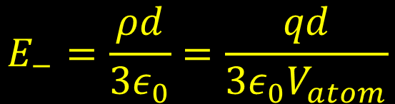
DIelectrics have DIPOLES
Consider a single neutral atom +q, –q
– electron ‘cloud’
a
+ nucleus
An external field E is applied
Center of + , – charge displaced
Dipole moment!
-
d
$$E_{−}=\frac{ρd}{3ε_{0}}=\frac{qd}{3ε_{0}V_{atom}}$$
Electric field due to – cloud at nucleus
+
E
To keep atom stable: E₋ = E
Polarization ≡ Dipole moment per unit volume

Slide 4


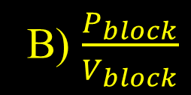
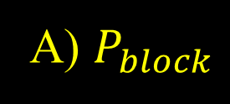
There is ‘bound’ charge inside a dielectric
When an electric field is applied, all the unit dipoles inside align themselves along the field
The figure above shows a block of material with volume V_{block}
It’s polarization is P_{block} The total dipole moment is:
A) $P_{block}$
B) $\frac{P_{block}}{V_{block}}$
C) $P_{block}∗V_{block}$
Notes:
The picture shows atomic dipoles. In general, can have complex molecules (CO2, H2O, solid compounds etc)
Question is to drive in units of Polarisation=C*m^-2 Dipole moment = C*m

Slide 5
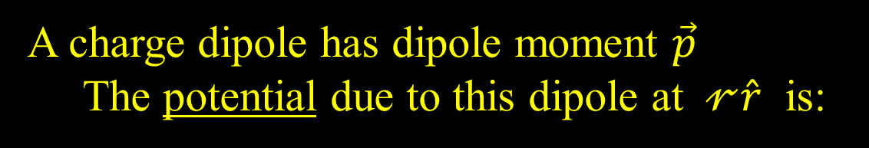
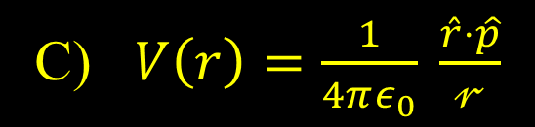
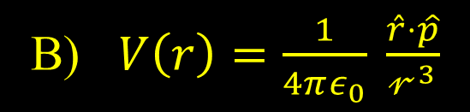
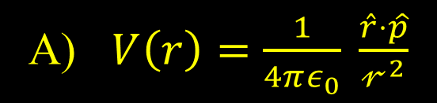
Question: what V(r) due to a dipole?
A charge dipole has dipole moment $\vec{p}$
The potential due to this dipole at $𝓇\hat{r}$ is:
A) $V\left(r\right)=\frac{1}{4πε_{0}} \frac{\hat{r}⋅\hat{p}}{𝓇^{2}}$
C) $V\left(r\right)=\frac{1}{4πε_{0}} \frac{\hat{r}⋅\hat{p}}{𝓇}$
B) $V\left(r\right)=\frac{1}{4πε_{0}} \frac{\hat{r}⋅\hat{p}}{𝓇^{3}}$
Since we have established that a dielectric
contains dipoles, the dipole term is dominant in the multipole expansion. It is sufficient to perform all our further calculations using dipoles – the higher poles don’t matter!
Notes:
Correct = (A)
Recall question for multipole moments. The power in the denominator matters for the math to calculate surface and bound charges.

Slide 6





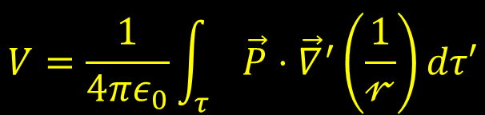
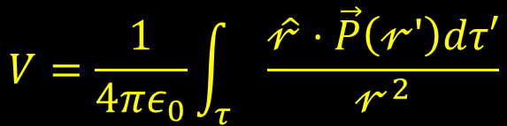
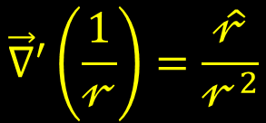
Dielectric creates an electric potential
Evaluate potential
$$P(\hat{𝓇})$$
$$𝓇$$
Ignore the external field that created these dipoles, what is the field created BY the dipoles?
$$dτ′$$
$$\vec{p}=\vec{P}\left(𝓇^{′}\right)dτ′$$
$$τ$$
Dipole moment of this piece
$$V=\frac{1}{4πε_{0}}\int_{τ}{\frac{\hat{𝓇}⋅\vec{P}\left(𝓇′\right)dτ′}{𝓇^{2}}}$$
$${\vec{∇}}^{′}\left(\frac{1}{𝓇}\right)=\frac{\hat{𝓇}}{𝓇^{2}}$$
$$V=\frac{1}{4πε_{0}}\int_{τ}{\vec{P}⋅{\vec{∇}}^{′}\left(\frac{1}{𝓇}\right)dτ′}$$

Slide 7
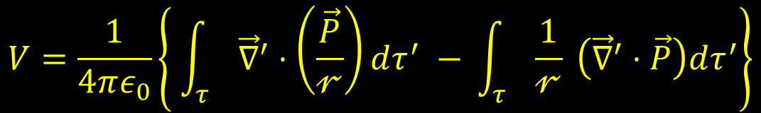
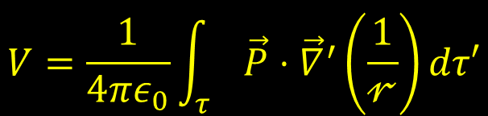
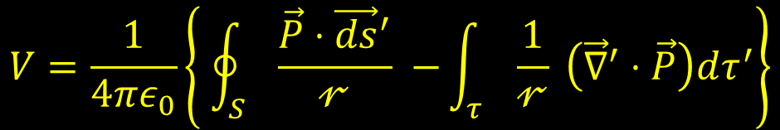
Dielectric potential has two parts
$$V=\frac{1}{4πε_{0}}\int_{τ}{\vec{P}⋅{\vec{∇}}^{′}\left(\frac{1}{𝓇}\right)dτ′}$$
Integrate by parts
$$V=\frac{1}{4πε_{0}}\left\{ \int_{τ}{{\vec{∇}}^{′}⋅\left(\frac{\vec{P}}{𝓇}\right)dτ^{′} − }\int_{τ}{\frac{1}{𝓇} }\left({\vec{∇}}^{′}⋅\vec{P}\right)dτ^{′}\right\}$$
Divergence theorem
$$V=\frac{1}{4πε_{0}}\left\{ \oint_{S}{\frac{\vec{P}⋅{\vec{ds}}^{′}}{𝓇} −}\int_{τ}{\frac{1}{𝓇} }\left({\vec{∇}}^{′}⋅\vec{P}\right)dτ^{′}\right\}$$
SURFACE
VOLUME

Slide 8

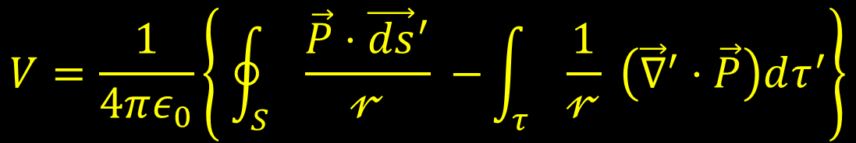

Dielectric polarization leads to Surface and Volume (bound) charge
$$V=\frac{1}{4πε_{0}}\left\{ \oint_{S}{\frac{\vec{P}⋅{\vec{ds}}^{′}}{𝓇} −}\int_{τ}{\frac{1}{𝓇} }\left({\vec{∇}}^{′}⋅\vec{P}\right)dτ^{′}\right\}$$
$$σ_{b}=\vec{P}⋅\hat{n}$$
$$ρ_{b}=−\vec{∇}⋅\vec{P}$$

Slide 9
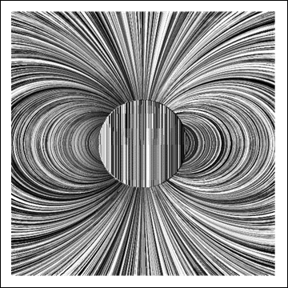



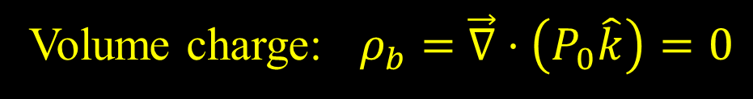

Example 1
Consider a sphere with polarization $P_{0}\hat{k}$
Surface charge: $σ_{b}=$ $P_{0}\hat{k}⋅\hat{n}=P_{0}cosθ$
z
$$\hat{n}$$
θ
Volume charge: $ρ_{b}=$ $\vec{∇}⋅\left(P_{0}\hat{k}\right)=0$
.
P
R
+
-
E

Slide 10




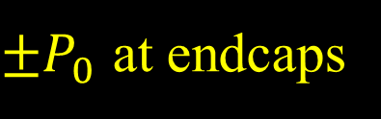
Example 2
A tube of dielectric has polarization $P_{0}\hat{k}$
Surface charge $σ_{b}= ?$
${±P}_{0}$ at endcaps
Volume charge $ρ_{b}= ?$
0
+
Chemical reaction inside a battery produces polarization and charge at the endcaps
Normally this charge is bound to the battery
With load connected, there is sufficient external potential for the charge to become free
–

Slide 11
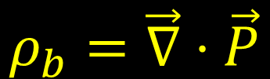

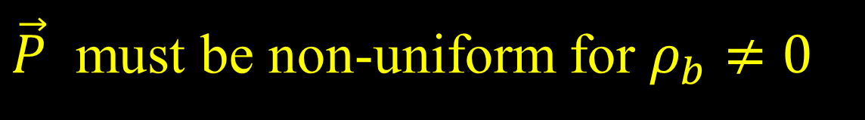
When does $ρ_{b}≠0?$
$$ρ_{b}=\vec{∇}⋅\vec{P}$$
$\vec{P}$ must be non-uniform for $ρ_{b}≠0$

Slide 12
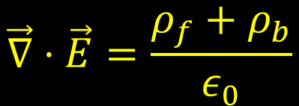
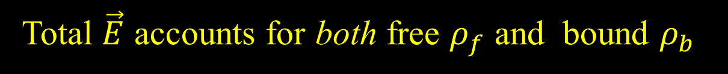


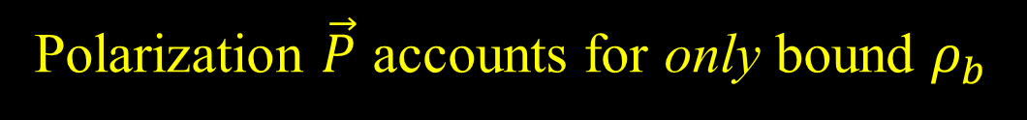
We must extend Gauss’s law to include dielectrics
Total $\vec{E}$ accounts for both free $ρ_{f}$ and bound $ρ_{b}$
$$\vec{∇}⋅\vec{E}=\frac{ρ_{f}+ρ_{b}}{ε_{0}}$$
Polarization $\vec{P}$ accounts for only bound $ρ_{b}$
$$\vec{∇}⋅\vec{P}=−ρ_{b}$$
We define a ‘Displacement’ field: $\vec{D}≡ε_{0} \vec{E}+\vec{P}$

Slide 13
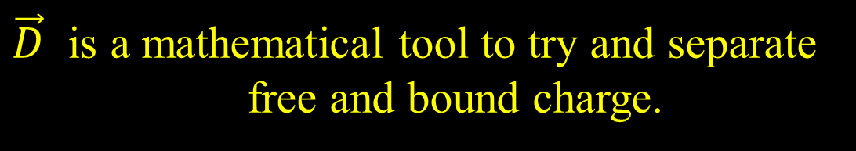
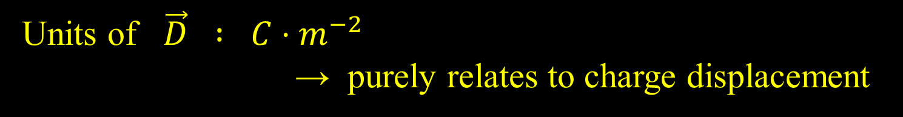
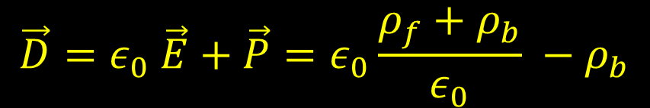
$\vec{D}$
$\vec{D}$ is a mathematical tool to try and separate
free and bound charge.
$$\vec{D}=ε_{0} \vec{E}+\vec{P}=ε_{0}\frac{ρ_{f}+ρ_{b}}{ε_{0}} −ρ_{b}$$
Units of $\vec{D} : C⋅m^{−2}$ → purely relates to charge displacement
In integral form: $\int{\vec{∇}⋅\vec{D} dτ}= \oint{\vec{D}⋅\vec{dσ}=} Q_{f|enclosed}$

Slide 14
Applications of Gauss’s law for dielectrics
Next lecture
… and in tutorials

